Slide 1
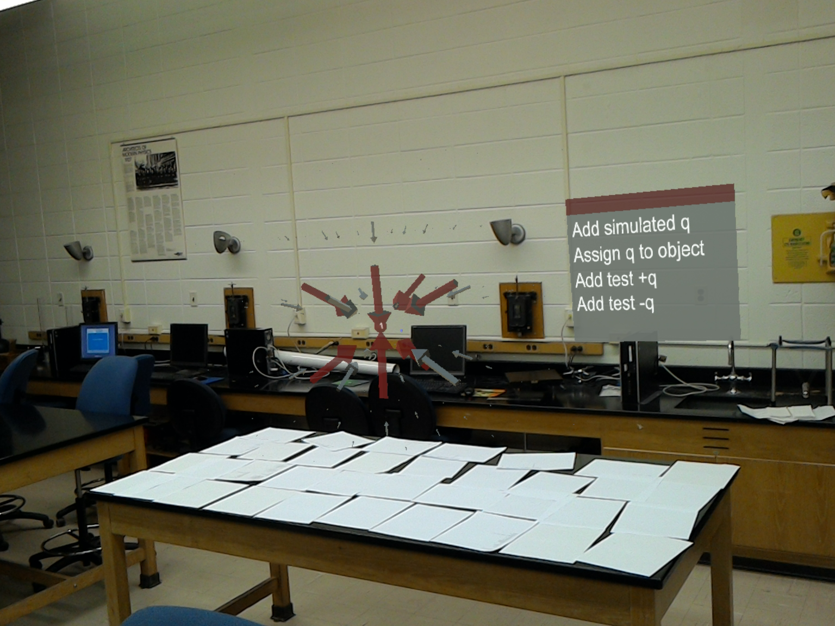
Interacting with Simulated Charges and Fields via Augmented Reality
Steven Binz
February 20th, 2017

Slide 2
Augmented Reality in Education
Long history and many different definitions
Wu, H.-K., Lee, W.-Y., Chang, H.-Y., & Liang, J.-C. Current status, opportunities and challenges of augmented reality in education. Computers & Education, 62, 41-49 (2013); doi: http://dx.doi.org/10.1016/j.compedu.2012.10.024
Akcayir, M., Akcayir, G. Advantages and challenges associated with augmented reality for education: A systematic review of the literature. Educational Research Review, 20 (2017) pp 1-11 http://dx.doi.org/10.1016/j.edurev.2016.11.002
Studies have shown it can be effective
Chen, Y.-C., Chi, H.-L., Hung, W.-H., & Kang, S.-C. Use of tangible and augmented reality models in engineering graphics courses. Journal of Professional Issues in Engineering Education and Practice, 137 (4), 267–276 (2011).
And many more!
Many limitations
Has not yet become widespread
Notes:
AR has a long history in education.
Modern hardware goes a long way in fixing that.

Slide 3
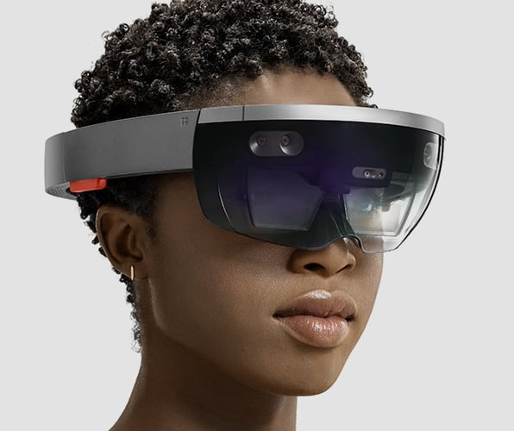
Advantages of Modern Devices
Easy to use interface
A single mass market device
Comfortable enough to be worn for an hour
Multi-purpose
Portable
Microsoft HoloLens, device used for this work
https://www.microsoft.com/microsoft-hololens/en-us/hardware , January 28th, 2017
Notes:
Device:
Full computer, does not need to be tethered to anything else
Sensors and software to map the room so it knows where everything that is not moving is
Two transparent screens that allow you to see the world around you and insert computer graphics into the view

Slide 4
Goal of this Work
Help students learn by
placing the abstract concept of electric fields into the real world
actively engaging them

Slide 5
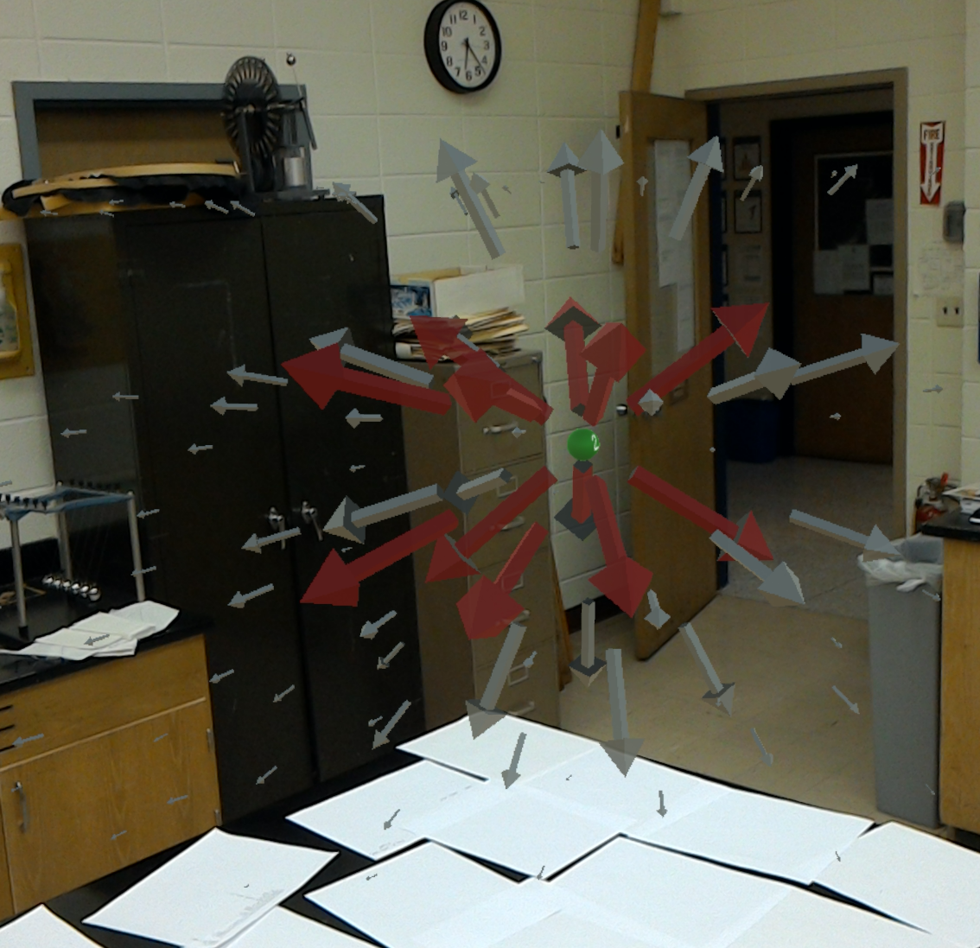
The Simulation
Open ended
Simple controls
Look
Walk
1-click
Voice commands
Place charges and test charges
Notes:
Interface
Cursor!
Red vectors
Next videos

Slide 6
Videos

Slide 7
Next Steps
Add features
Assign simulated charges to real world objects and let people physically move them
Magnetic fields and electric currents
Potentials & more
Study effectiveness
Build library of programs that run on Microsoft’s Holographic API
The time for AR is NEAR!

